Slide 1
Simulated Clinical Placement (DATES)

Slide 2
Simulated Clinical Placement
Practice
Simulation
Skills
Tutorial
Lecture
Notes:
How about we try to introduce a different way for students to practice their clinical skills? A person learning to drive can practice with a driving simulator before hitting the road. Similarly, students can develop professional competencies and clinical skills in a simulated learning environment.
You will be attending a simulated clinical placement to develop your professional competencies and clinical skills in the coming weeks. So, what is simulation in your educational context?
What can you expect in a simulated clinical placement?

Slide 3
Welcome
Health Enhance Occupational Therapy
A national organisation providing a wide range of services in five states in Australia
New South Wales
Queensland
South Australia
Victoria
Western Australia
Service area:
Acute Hospital, Physical rehabilitation, Mental Health, Vocational Rehabilitation
Notes:
Welcome to Health Enhance! I am your simulated clinical placement site coordinator here and am very leased to meet you all on your first day of placement.
You will be having a one week placement here at our physical rehabilitation unit/ mental health unit/ employment services. I will tell you more about Health Enhance, what do we expect from students on placement and what will happen during this week. Then, I will introduce you to your clinical supervisors and simulation facilitators who will support your learning this week.
We service the occupational therapy needs of clients of the Health Enhance network in the areas of physical occupational therapy, vocational occupation therapy, and mental heal occupational therapy. That makes us one of the largest and most diverse occupational therapy placement providers nationally, with branches in five states across Australia. You will be completing your placement experience in one of our three placement "streams" at one of our seven branch offices.
We work closely with occupational therapy departments in a number of Australian universities. Our current placement program has been designed in partnership with Australian Catholic University, Curtin University, Deakin University, University of Newcastle, University of South Australia, and University of Sydney.
Click the links to the right to find detail on how you will be assessed, resources for your placement organised by the "type" of placement you are completing (physical, vocational, or mental health), and forms we ask you to complete so that we can continually improve our programs.

Slide 4
Learning focus
Professional self conduct;
Self-management skills;
Effective communication with coworkers and service users and ability to work as part of a team;
Skills in effective client information gathering from a range of sources;
Ability to identify a client’s occupational performance issues and assess the impact of environmental and social factors on the client’s ongoing participation and engagement.
Notes:
Professional self conduct;
Self-management skills, (i.e. effective time management, assuming responsibility for own learning, demonstrating initiative and taking responsibility for own actions and responses to supervision and constructive feedback);
Effective communication with coworkers and service users and ability to work as part of a team;
Skills in effective client information gathering from a range of sources;
Ability to identify a client’s occupational performance issues and assess the impact of environmental and social factors on the client’s ongoing participation and engagement;

Slide 5
Expectation of students
Demonstrate professional behaviours
Work hours:
9 am to 5 pm, 15 minutes morning tea and 30 minutes lunch break
Be on-time
Work attire:
Uniform, name badge, non-slip flat closed in shoes, no jewellery, hair tied back, no nail polish
Actively participate in learning activities including observation, interviews, assessments, group work, intervention plan, documentation and presentations.
Work independently and in collaboration with other students.
Work with your clinical supervisors and simulation facilitators .
Provide professional documentation and presentations according to guidelines provided by your clinical supervisors.
Mange your time and your work.
Notes:
Actively participate in learning activities
Be prepared, ask questions, contribute, communicate your clinical reasoning with your clinical supervisors and simulation facilitators.
Work independently and in collaboration with other students
You will be mostly working in groups but you will be given tasks that you need to do on your own.
It is a great opportunity for you to learning to work as a team as that you can learn how to allocate work, communicate with each other effectively and learn from each other.
Time Management
You will be challenged to manage time effectively. You will find out when you have appointment with your clients. You may need to arrange therapy for communication time with your client and file you clinical notes on time. You may be asked to do research on your cases and other tasks allocated to you.

Slide 6
Safety Issues
Work health and safety
Ensure safety for yourself and others in the workplace
Patient safety
Manual handling
Infection control
Privacy of patient information
Risk assessment for therapy
Notes:
WHS – brief students on emergency procedure of the facility, Code system if applicable
Incident reporting - you should inform you clinical supervisor or simulation facilitator as soon as possible if incident occurs.
Make you that your client is safe
Your clinical supervisor or simulation facilitator will review manual handling, hand hygiene and privacy issues you need to aware of
Make sure to check the equipment you used and consider possible risk before conducting assessment and therapy.

Slide 7
Site Coordinator
Simulation Facilitator
Prac group 1
Prac
Group 2
Clinical supervisor
Prac group
Sub group A
Subgroup B
Subgroup C
Notes:
Site Coordinator
Role: Coordinates all aspects of the simulated clinical placement. Is available during the SCP to troubleshoot and support staff involved in the SCP
Clinical Supervisors
Role: Practicing occupational therapist employed to provide clinical guidance to students. Supervises 1 GROUP of students, Complete SPEF-R, hand to student
Simulation Facilitators
Role: Supports CLINICAL SUPERVISORS. Supports two GROUPS of students in general, professional (non-clinical) skills..

Slide 8
Simulated Clinical Placement: Monday
Welcome
Group orientation
Set up for your place
Observe initial assessment interview
Prepare for your first case
Notes:
After the orientation, you will go to your “office” with your clinical supervisor. Your clinical supervisor will introduce the occupational therapy service Health Enhance offer and clinical process involved.
You will also receive your first referral for this week.

Slide 9
Simulated Clinical Placement: Tuesday
Your first initial assessment
Collect further information to formulate your assessments and intervention plans
Document your assessment , complete progress notes
Prepare for further assessment or intervention
Record all your interviews and save them on a USB stick for your clinical supervisor to review

Slide 10
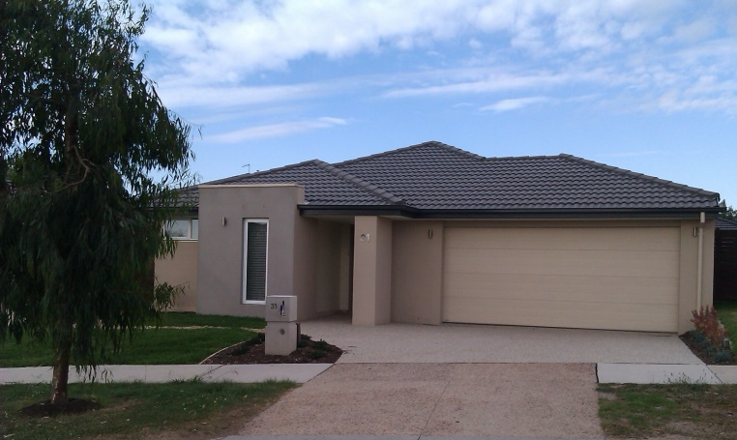
Simulated Clinical Placement: Wednesday
Worksite visit
Second referral

Slide 11
Simulated Clinical Placement: Thursday
Formulating intervention or discharge plan
Case conference

Slide 12
Simulated Clinical Placement: Friday
Each sub group will present to their clinical supervisor:
A summary of their case
Assessment findings
Intervention plan
Discharge plan
Recommendations
3 subgroups work together to produce a group presentation for the class
Student evaluation and assessment

Slide 13
Reflection & Debriefing
Focus on three SCP Learning Outcomes
effective self-management skills;
Written and oral communication with clients and stakeholders;
Effective information gathering skills;

Slide 14
Things you need to complete
Daily
Daily Work Statistics (due by 5pm)
Reflective Log
For your primary case (per subgroup)
Daily progress notes
Video and audio recordings of interviews (submit to CS on Wednesday)
Initial assessment report, further assessment reports, intervention plan, discharge plan and recommendations (submit to CS on Thursday)
Case presentation (submit to CS on Thursday)

Slide 15
Things you need to complete
For your Observation of initial assessment
Interview observation checklist
Initial Assessment Form
Progress Report
For your secondary case (individual)
Upload to Case conference forum before mini case conference

Slide 16
Things you need to complete
Final Day to Placement
Complete SPEF-R Self-evaluation and bring it to your clinical supervisor
Submit time sheet signed by clinical supervisor to site coordinator
Complete and sign SPEF-R

Slide 17
Q & A

